Slide 1
Smart Robot project
Изготвили: Дмитро Богдев, 855295 Богдан Карабаджак, 855300

Slide 2
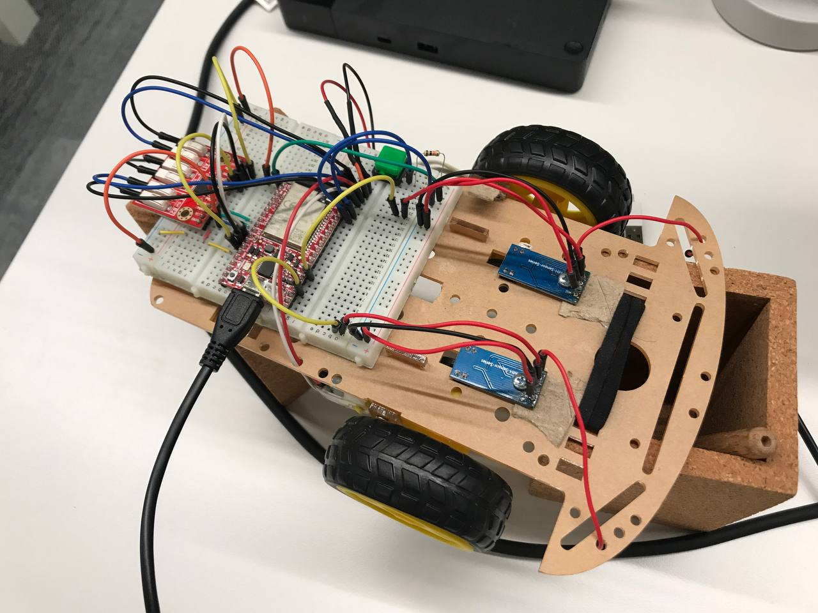

Robot’s view

Slide 3
Architecture overview
Server part – ESP32
WIFI
UDP connection
Python client
Open-CV Artificial intelligence

Slide 4
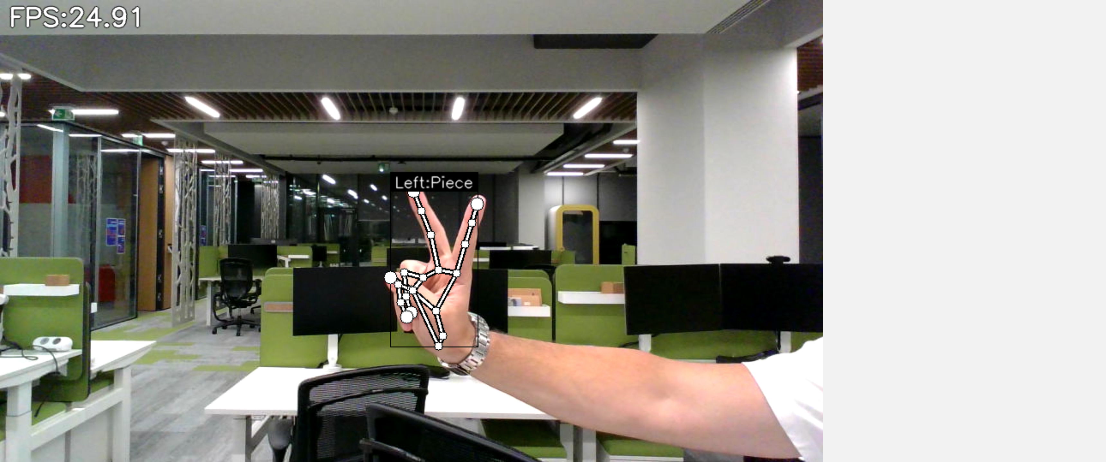
Hand-Gesture Recognition

